Slide 1
COS 102: INTRODUCTION TO PROBLEM SOLVING
(3 UNITS)
Module 3: Basic Algorithm Implementation Strategies
Unit 1: Decision table, and Decision tree

Slide 2
Learning Objectives:
Students can build a decision tree that correctly represents a sequence of decisions and their possible outcomes for a given problem.
Students can list and explain the components of a decision table, including conditions, actions, rules, condition stubs, and action stubs
Students can select the appropriate method (decision table or decision tree) for different types of decision-making scenarios

Slide 3
Decision tables
Decision table is a graphical representation of an algorithm for making some simple and complex decision. A decision table consists of four components as shown on the next slide:
Decision tables critical tools in computer science, particularly for problem solving. They contribute to representing complex decision-making processes and making them more understandable and manageable.

Slide 4
Condition/Attribute Component: This component consists of the conditions or attributes based on which a decision or conclusion is made.
Condition/Attribute Component | Condition/Rule Applied Component
Action/Conclusion Component: | Action/Conclusion/Decision Taken Component:
Condition/Rule Applied Component: This component contains the rules or condition alternatives
Component of Decision table

Slide 5
Action/Conclusion Component: This component contains the actions to be taken for the combination of conditions specified in the rule applied component
Action/Conclusion/Decision Taken Component: This component contains conclusion or decision selection from set of possible conclusions or decisions

Slide 6
To understand each component of a decision table, let’s consider the following problem as example:
Candidate can be a male or female
Female candidates should be married
Candidates should possess minimum of five (5) credit in five O’level subjects including English and Mathematics
Problem 1: let’s represent eligibility of admission into an anonymous University with the following eligibility instruction in a decision table:
Candidates should not be less than 16years of age (for both gender)

Slide 7
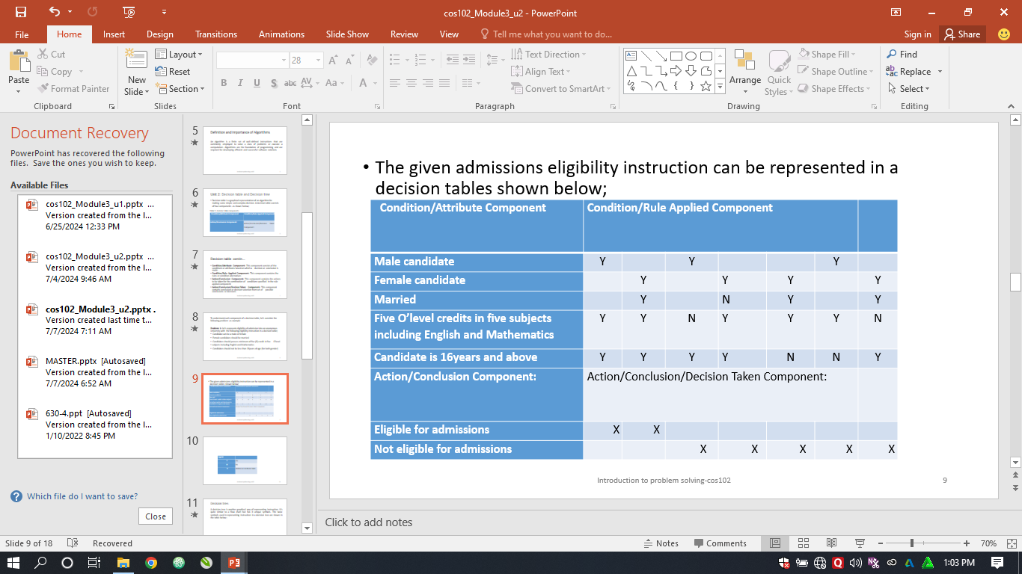
The given admissions eligibility instruction is represented in the decision tables shown below:
Legend
Y | Yes
N | No
X | Decision or Conclusion taken

Slide 8
Decision tree
A decision tree is another graphical way of representing instruction. It’s quite similar to a flow chart but has it unique symbols. The basic symbols used in representing instruction in a decision tree are shown in the table below:
Symbols | Represents
oval | The symbol represents a condition or attributes node
rectangle | The symbol represents a decision, conclusion or leaf node
arrow | The symbol represents a direction flow or indicates a branch

Slide 9
In a decision tree, decision starts from a root node (the first condition or attribute node) to the leaf node in traverse.
To understand traverse movement between attribute nodes to a leaf node, let’s consider the following problems as an example:
It starts from the root node, testing the attribute specified by this node and then moving down the tree branch according to the attribute value in the given set.

Slide 10
Problem 2: let’s represent an instruction for an assumed loan payment defaulting
Home owner
.
Yes No
Will not default
Married
loan payback
Yes No
Will default loan
Will not default
payback
loan payback

Slide 11
Conclusion
Understanding their structure, uses, and advantages enables better decision-making, clearer communication of complex logic, and more efficient design of systems and algorithms.
Both decision tables and decision trees are powerful tools in computer science for modeling and analyzing decision processes.

